Slide 1



PJVelasco Data2 Apocolypse Food Prep - Relationship Tutorial
View in Power BI
Last data refresh:
17/04/2025 4:11:32 pm UTC
Downloaded at:
18/04/2025 12:18:16 am UTC

Slide 2
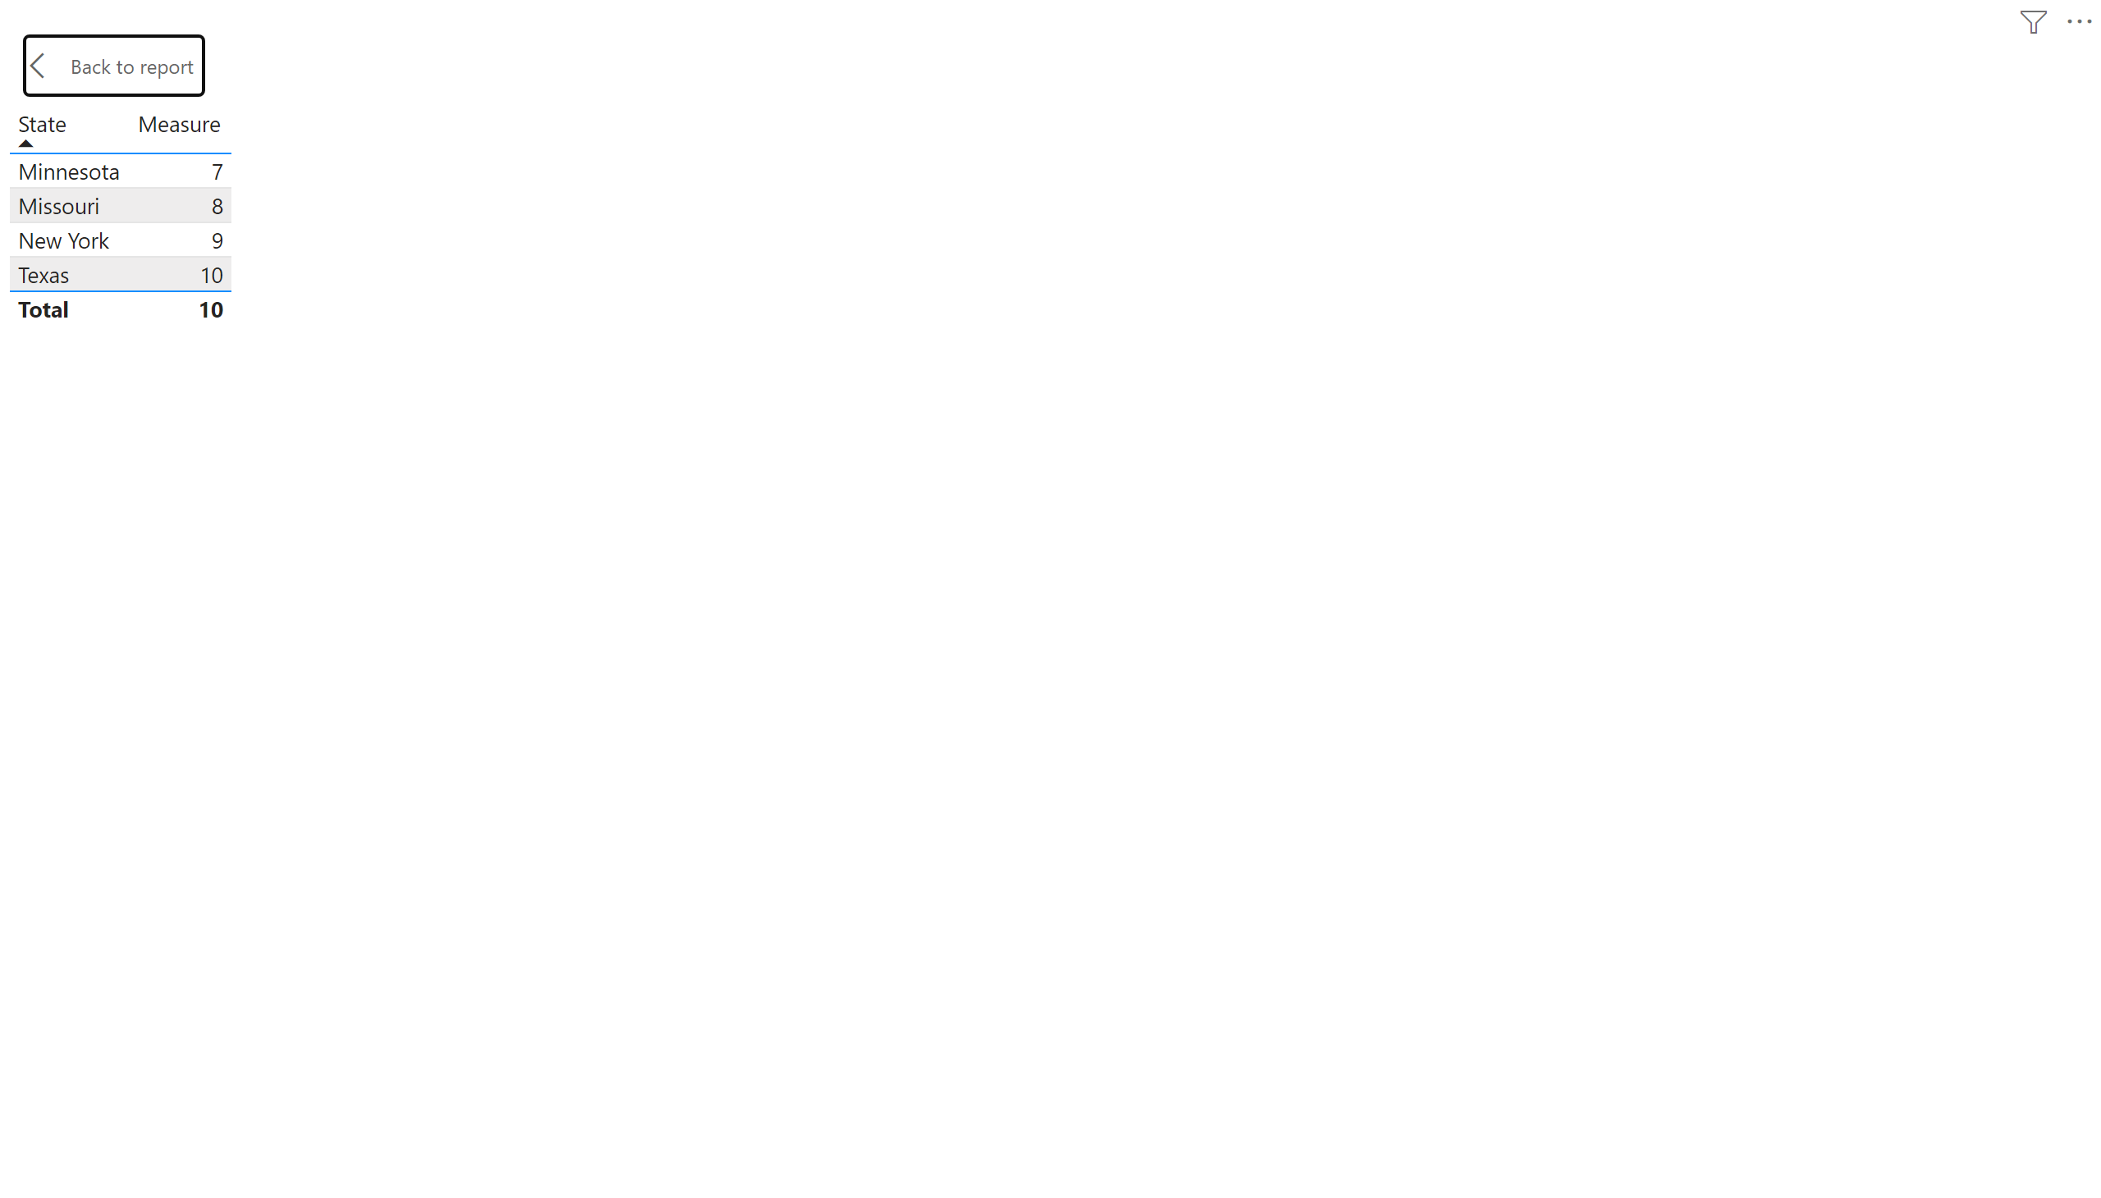
Page 1
Notes:
tableEx
No alt text provided

